Slide 1

CHIRON - AI that listens ethically, responds empathetically
AI Enthusiasts
TEAM MEMBERS
SANA AMBREEN
MADHUMITHA NATESAN
PRIYADARSHINI BALASUBRAMANIAN
MOHAMMAD MAHMUD

Slide 2

Introduction
According to WHO, 1 in 4 people experience mental health issues at some point, yet over 60% never receive professional help.
Mental-health demand is rising, but access is limited (wait times, cost, stigma), and many chatbots are unsafe or hallucinate.
There’s a clear need for a safe, accessible, and emotionally intelligent digital companion that supports users responsibly.
Target audience includes individuals seeking emotional support, mental-health clinicians, and organizations promoting psychological wellbeing

Slide 3
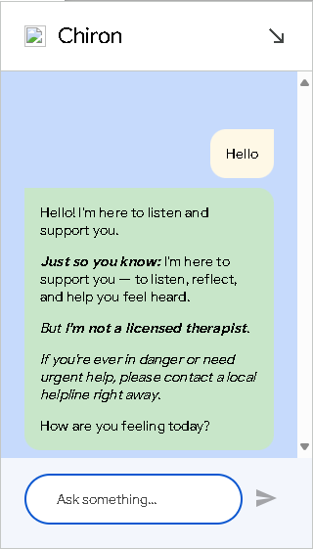
CHIRON: A Safe & Ethical AI Companion for Mental Health
Build an emotionally-intelligent chatbot that detects depression signs through conversation, provides safe empathetic support, and connects users to real resources - without collecting personal data.
Chiron AI is a voice-enabled, empathetic conversational agent built on Dialogflow CX + Vertex AI Playbooks to provide safe, ethical, and human-like mental health support.
It bridges the gap between emotional need and professional help, ensuring trust, privacy, and zero hallucinations.

Slide 4

Key features of Chiron
Empathetic, context-aware conversations powered by Vertex AI Playbooks
Built-in hallucination guard for factual, ethical responses
Real-time sentiment and emotion detection for adaptive tone
Automatic crisis detection and safe redirection to verified helplines
Voice input through Google Cloud Speech integration
Privacy-first design with zero personal data storage
Modular Dialogflow CX Playbook structure for reusable conversation flows
Grounded in verified mental-health resources and ethical communication standards

Slide 5

Future Scope
Expand multilingual and multimodal capabilities for inclusive global access
Integrate clinician dashboard and wearable data for early intervention insights
Connect verified therapy and wellness event APIs for real-time community support
Deploy as a privacy-first Progressive Web App for continuous accessibility
CHIRON redefines responsible emotional AI bridging empathy, ethics, and technology for safer mental health support

Slide 6
Thank You!

